Slide 1
Calvert Cliffs A Case for Change
Thomas Trepanier
Constellation Energy Nuclear Group
Plant General Manager, Calvert Cliffs Nuclear Power Plant

Slide 2
Calvert Cliffs Strengths
Respect
Pride
Driven/Caring workforce
Potential
Reacting to crisis
Teamwork
Rallying/solving issues
Plant Ownership
Talented People
Flexible Workforce
People Like Each Other
Coaching & Accepting of Coaching
Go Beyond “Normal” Boundaries
Process Driven

Slide 3
Calvert Cliffs History through 2010
INPO 1 for over 10 years
Unit 2 world PWR record for consecutive days online (692 days)- 2009
Record breaking capacity factor- 2008
Top decile cost performance
Outage and dose performance continuously improving
However:
Rising backlogs
Gaps in manning
INPO AFI points out overconfidence in areas of strong performance

Slide 4
Calvert Cliffs Dual Unit Trip
February 18th, 2010
Roof leak causes short in electrical bus, trips Unit 1 RCP and Unit 1 trips
Failure of a relay causes the short to cascade over to Unit 2- Loss of Unit 2 13KV, Unit Trip, Loss of Normal Heat Sink
2B diesel generator fails to load and trips due to low margin and a degraded Agastat on the lube oil system

Slide 5
Calvert Cliffs Dual Unit Trip
Significant Event- SEN 283
Unit 2 was on backup heat removal (Auxiliary feedwater and atmospheric dump valves for several days)
Stressed organization entering Unit 1 outage
Potential White Finding on EDG performance- regulatory scrutiny
Impacts improvement initiatives- reactive rather than proactive

Slide 6
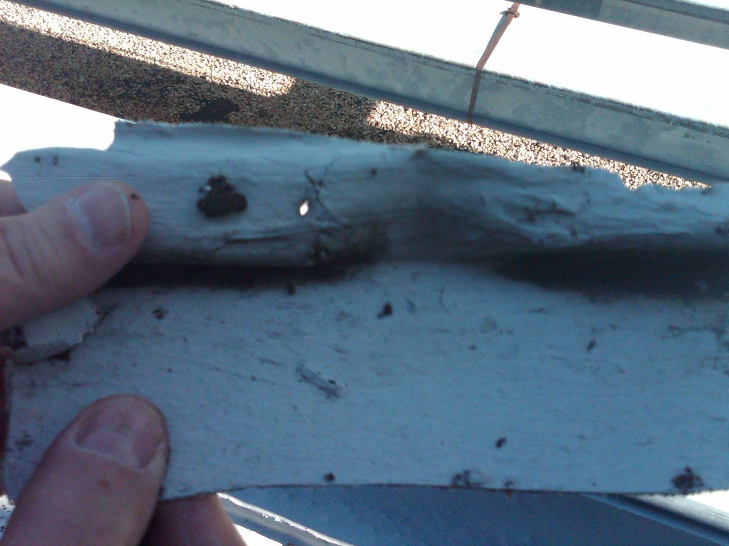
CCNPP Roof Leak

Slide 7
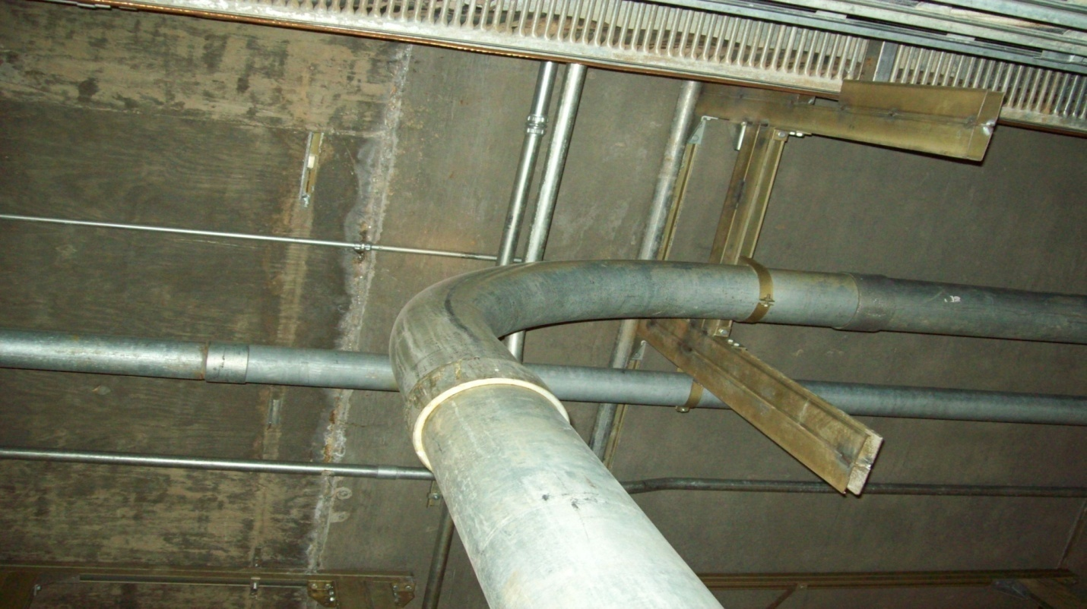
CCNPP Roof Leak

Slide 8
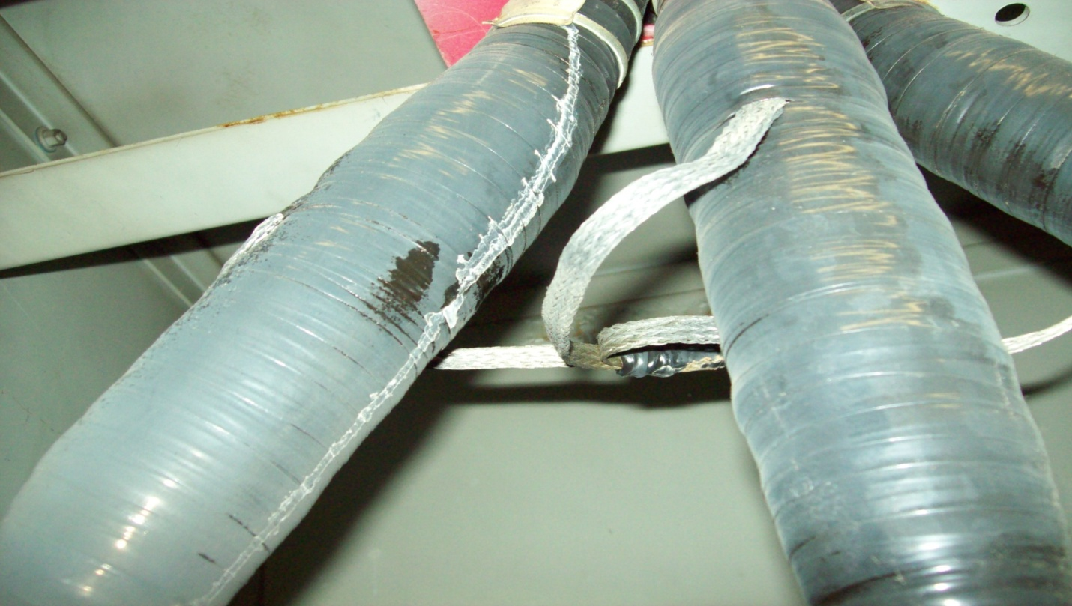
Ground fault

Slide 9
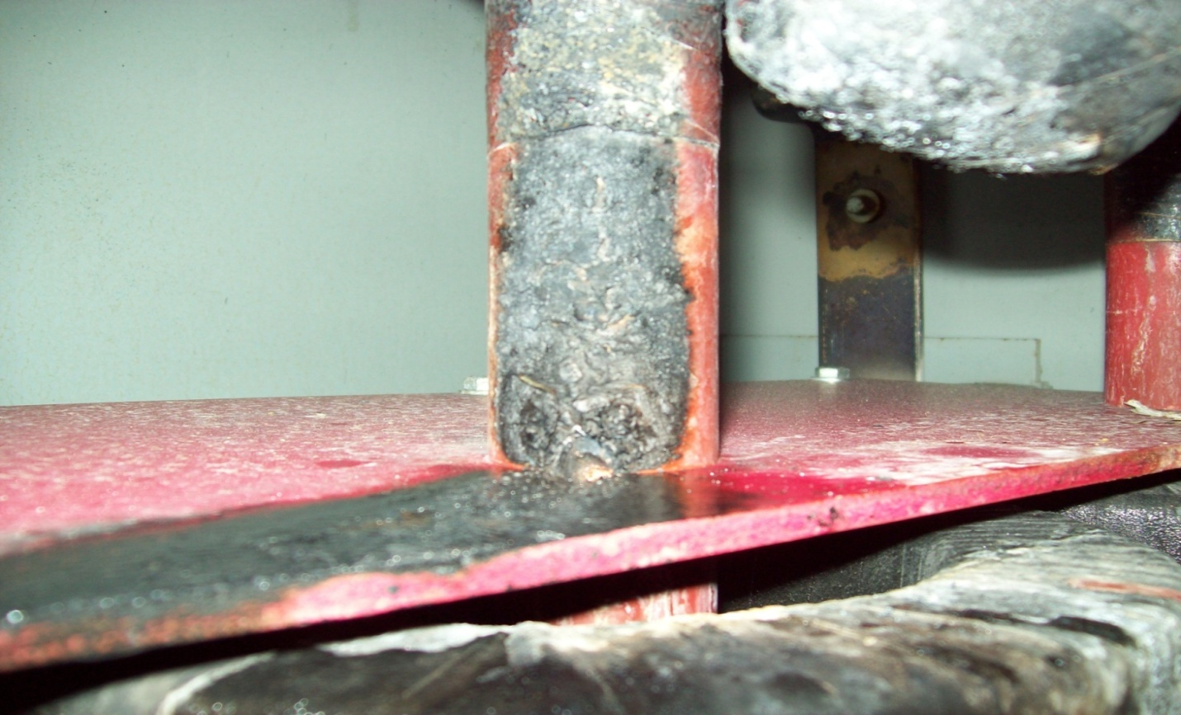
Ground fault

Slide 10
Ground fault

Slide 11
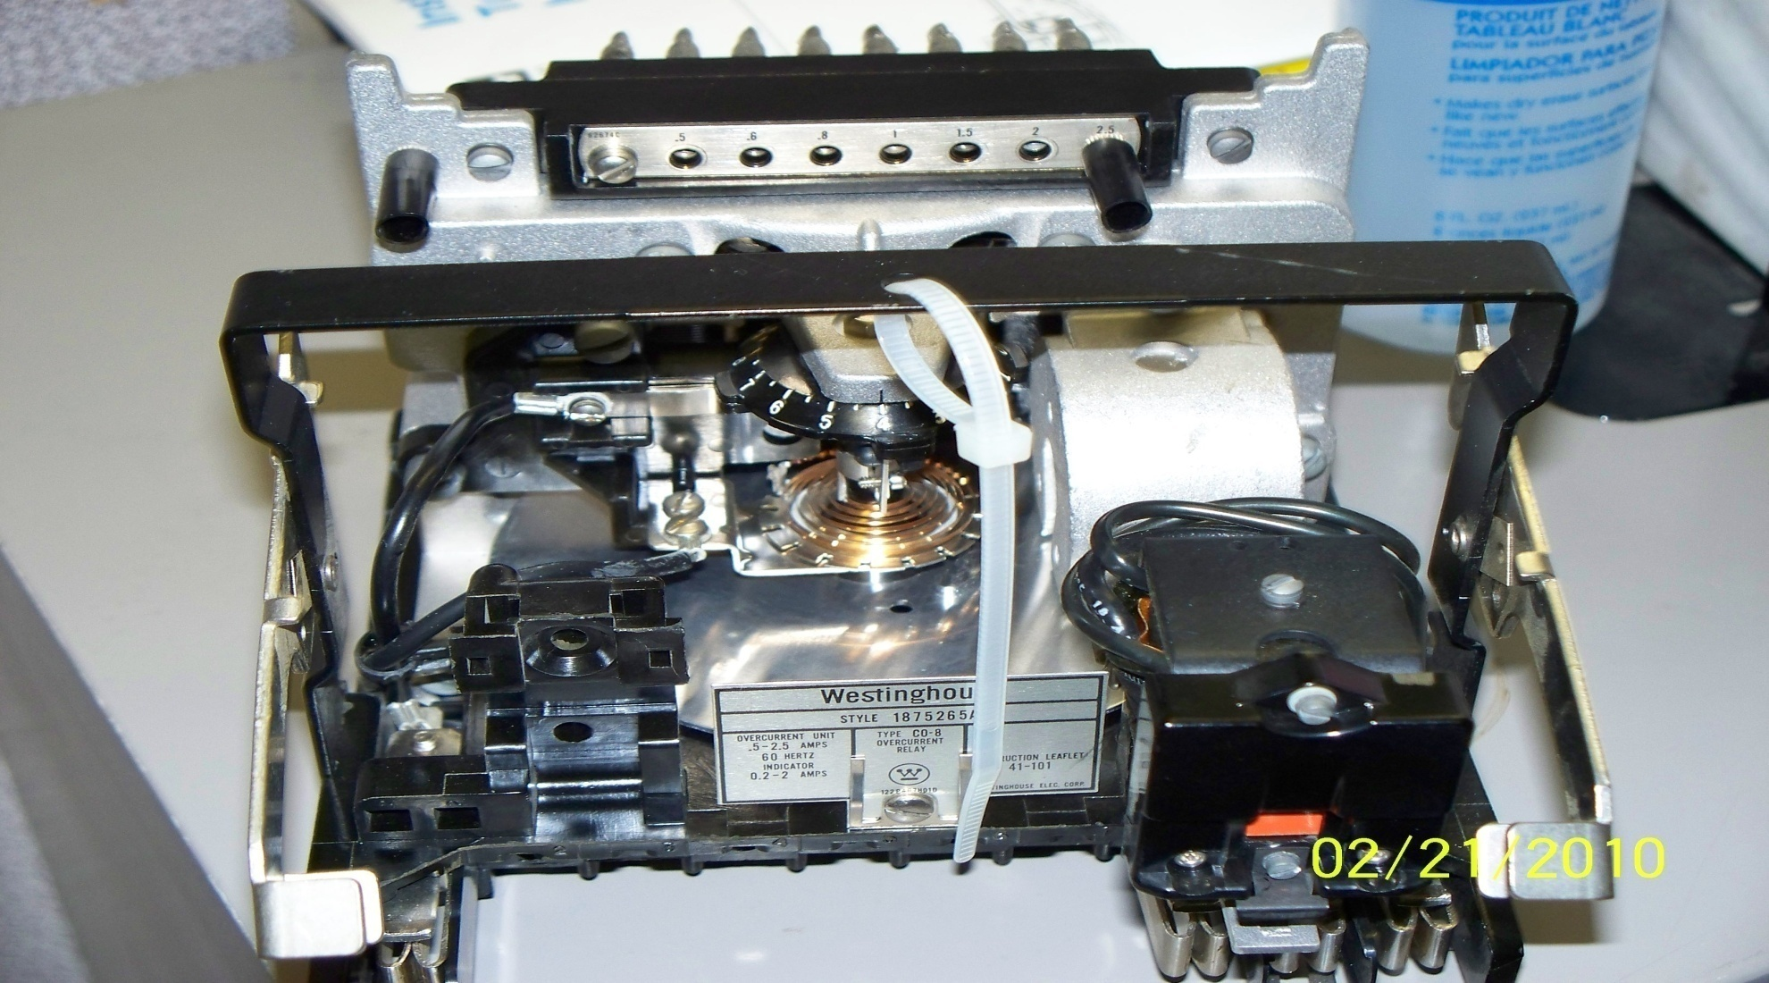
Fault Relay

Slide 12
2B EDG Time Delay Relay

Slide 13
So What?

Slide 14
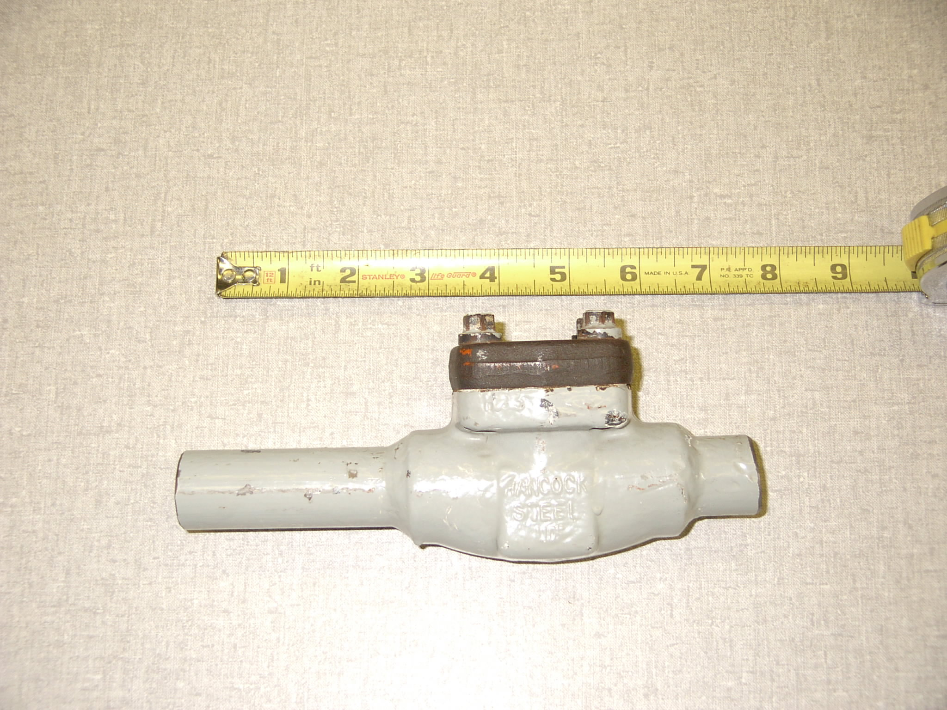
A World Famous Valve – Anyone Know?

Slide 15
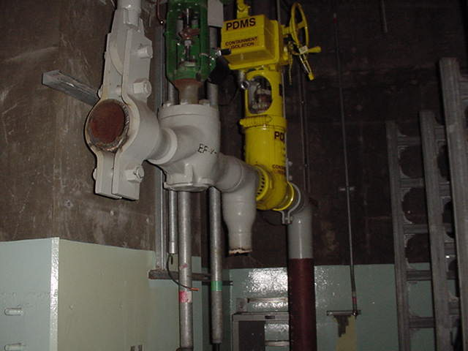
Three Mile Island

Slide 16
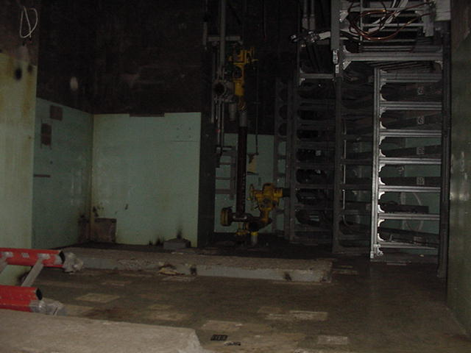
Three Mile Island

Slide 17
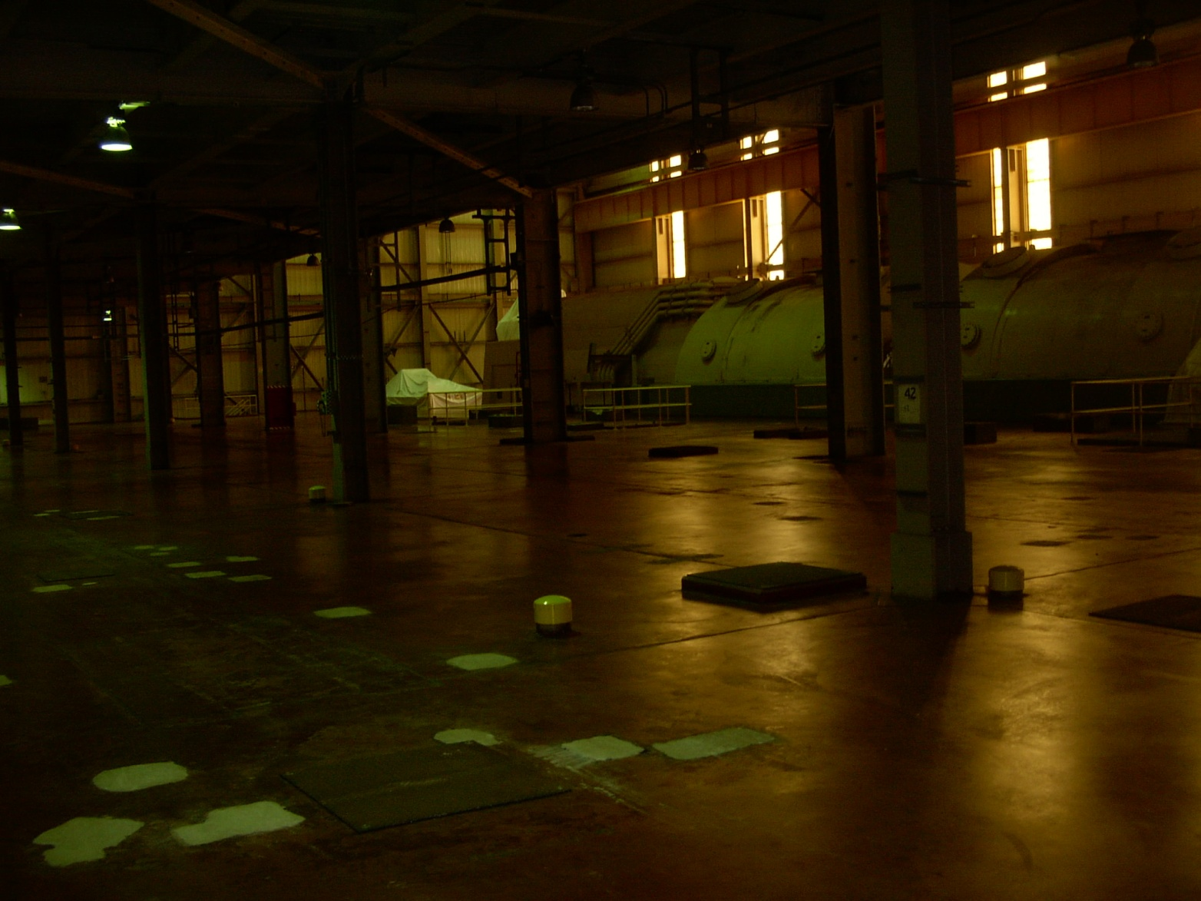
Three Mile Island

Slide 18
2010 Dual Unit Trip – Learnings from Root Cause
Root Causes
Roof Leaks (initial trip initiator)
The station had developed a reactive culture rather than a preventive strategy on dealing with roof leaks, thereby eliminating an increased sensitivity to and tolerating degraded roof conditions.
Electrical Malfunctions Leading to Unit 2 Trip
The station did not challenge and change an original design practice of normal system alignment with the cross station breakers closed feeding alternate RCP busses. This lineup allowed a single failure to allow a Unit 1 fault to propagate to Unit 2.
2B EDG Failure to Load
The station failed to recognize and quantify the low margin in the low lube oil pressure trip set feature for the EDG and did not rigorously assess all failure modes of an Agastat relay prior to extending it’s service life beyond the vendor recommended qualified lifetime.
Compensatory actions have been completed for all areas and extensive corrective actions are in progress for contributing causes and extent of condition

Slide 19
Dual Unit Lessons Learned
Other Learning’s not directly related to the event:
Lack of documentation of issues – not using CAP, not learning from small stuff
Quarantine – admin procedure
Lack of relay trending program- admin procedure
Set points of relays different than the design calculations
PORC – lack of healthy discussions to drive high levels of performance

Slide 20
Case for Change
Several equipment issues and program breakdowns combined to challenge the station the first six months of the year
Large backlogs are a ‘shot on goal’
Lost regulatory margin with the NRC & INPO
Program Gaps and backlogs are leading indicators of plant performance
Events are lagging indicators of the direction of the plant
“We must use these events as a burning platform to identify all issues and understand the extent of condition to arrest this decline and improve plant performance. Good human performance, fundamental behaviors and training prevented the situation from deteriorating.”
Notes:
Train weeks
cond booster pump oil sampling
SGFP speed Changes
Charging pps
2B EDG Speed Swings
Annuncaitor cards
Process Computer
R/Y System actions

Slide 21
Case For Change …
Aggressive action at first sign of decline
Embrace critical feedback – all sources
Intolerance, not dissatisfaction or rationalization
Engagement at all levels
Training & CAP valued as critical values
Genuine focus on Learning Culture
“These must be our burning platform for our Case for Change”

Slide 22
Case for Change
Challenge the status quo and past practices in a positive and supportive way
Keep what's good and build on it
Have a thirst for what good really looks like
Value training and CAP in building a learning organization
Don’t be victims – look to the future. Each of us needs to row forward, we each can have an impact
Have a sense of urgency in reducing the backlog
Participate in a case study in your department
Notes:
Train weeks
cond booster pump oil sampling
SGFP speed Changes
Charging pps
2B EDG Speed Swings
Annuncaitor cards
Process Computer
R/Y System actions

Slide 23
Case for Change- Human Performance
FLS Meetings- Review a standard each meeting- discuss and align
Procedure adherence- Admin procedure in hand day on Wednesdays
Observations
Deep observation program- leverage a strength via paired observations more focused report out
Reenergize WRAP- Behavior Based Observation Program

Slide 24
Case for Change- Human Performance
Human performance oversight board
Site Safety Committee Action Team
Department Specific DLA’s
Paired inspections of shops and office areas
Long range strategic plan-
Based on INPO 07-006

Slide 25
“A Thirst For What Good Looks Like

Slide 26
Calvert Cliffs- A Case for Change
Questions?

